Slide 2
React i ASP.NET Core - kombinacija iz snova
Toni Petrina
Massive Pixel d.o.o.
@to_pe
toni@massivepixel.co

Slide 3
Agenda
React intro
SPA
ASP.NET Core host
Zaključak

Slide 4
Što je ReactJS?
SPA Framework
Deklarativan
Funkcijski
Orijentiran na komponente
"Samo view layer"

Slide 5
React demo

Slide 6
React component
import * as React from 'react';
export default class Sample extends React.Component<any, any> { render() {
return <h4>Sample</h4>
}
}

Slide 7
Koliko novih stvari?
Moduli – import, export
NPM moduli
Klase/ES6
Typescript

Slide 8
Modules & import
import * as React from 'react';
export default class Sample extends React.Component<any, any> { render() {
return <h4>Sample</h4>
}
}

Slide 9
Typescript/ES6 class
import * as React from 'react';
export default class Sample extends React.Component<any, any> { render() {
return <h4>Sample</h4>
}
}

Slide 10
React component
import * as React from 'react';
export default class Sample extends React.Component<any, any> { render() {
return <h4>Sample</h4>
}
}

Slide 11
Ali to nije sve!
React component
JSX
Virtual DOM
Sintetički eventi
props
state
Webpack!

Slide 12
class => className
import * as React from 'react';
export default class Sample extends React.Component<any, any> { render() {
return <h4 className="title">Sample</h4>
}
}

Slide 13
for => htmlFor
import * as React from 'react';
export default class Sample extends React.Component<any, any> { render() {
return (
<div>
<label htmlFor="url" />
<input name="url" />
</div>
);
}
}

Slide 14
Props
class Sub extends React.Component<any, any> {
render() {
return <div>
<span>{this.props.text}</span>
<button onClick={this.props.handleClick}>Click me</button>
</div>
}
}
// parent component
<Sub text="nesto nesto" handleClick={e => alert('aha')} />

Slide 15
{expression}
{this.props.text}
// string interpolation
{`${x}`}
// expressions
{isVisible ? <div /> : null}
let x = 1
//…
return (
{x}
)

Slide 16
Kolekcije
<select>
{
[1, 2, 3].map((item, index) => {
return (<option>{item}</option>);
})
}
</select>

Slide 17
Kolekcije + key
<select>
{
[1, 2, 3].map((item, index) => {
return (<option key={index}>{item}</option>);
})
}
</select>

Slide 18
Props aka properties
Od roditelja djetetu
Možete slati i funkcije kao callback mehanizam
Ideja je da roditelj zna što treba djetetu

Slide 19
State
class Sample extends React.Component<any, any> {
constructor(props) {
super(props)
this.state = {
text: 'start'
}
}
render() {
return (
<div>
<input type="text" name="text" value={this.state.text} />
</div>
);
}
}

Slide 20
Change state?
class Sample extends React.Component<any, any> {
constructor(props) {
super(props)
this.state = {
text: 'start'
}
}
render() {
return <input type="text" name="text" value={this.state.text}
onChange={e => {
this.setState({ text: e.target.value});
}} />
}
}

Slide 21
Helper method
class Sample extends React.Component<any, any> {
constructor(props) {
//...
this.set = this.set.bind(this) // ES6
}
set(e) {
this.setState({ [e.target.name]: e.target.value })
}
render() {
return <input type="text" name="text" value={this.state.text}
onChange={this.set} />
}
}

Slide 22
State
Interno stanje komponente
State možemo slati niže
I na više komponente putem callbackova
State čuvamo u "najvišoj" komponenti u kojoj to ima smisla

Slide 23
Više ekrana? Routing!
export default <Route component={Layout}>
<Route path='/' components={{ body: Home }} />
<Route path='/counter' components={{ body: Counter }} />
<Route path='/fetchdata' components={{ body: FetchData }}>
<Route path='(:startDateIndex)' /> {
/* Optional route segment that does not affect NavMenu highlighting */
}
</Route>
<Route path='/sample' components={{ body: Sample }} />
<Route path='/sampleredux' components={{ body: SampleRedux }} />
</Route>;

Slide 24
SPA znači SPA
Single page – 1 index.html ili jedan view
Routing je client-side
Server side routing se može iskoristiti za teške stvari
Server side rendering je isto opcija

Slide 25
A gdje je ASP.NET?
https://blogs.msdn.microsoft.com/webdev/2017/02/14/building-single-page-applications-on-asp-net-core-with-javascriptservices/
dotnet new --install Microsoft.AspNetCore.SpaTemplates::*
mkdir app
cd app
dotnet new reactredux
dotnet restore
npm i
dotnet run

Slide 26
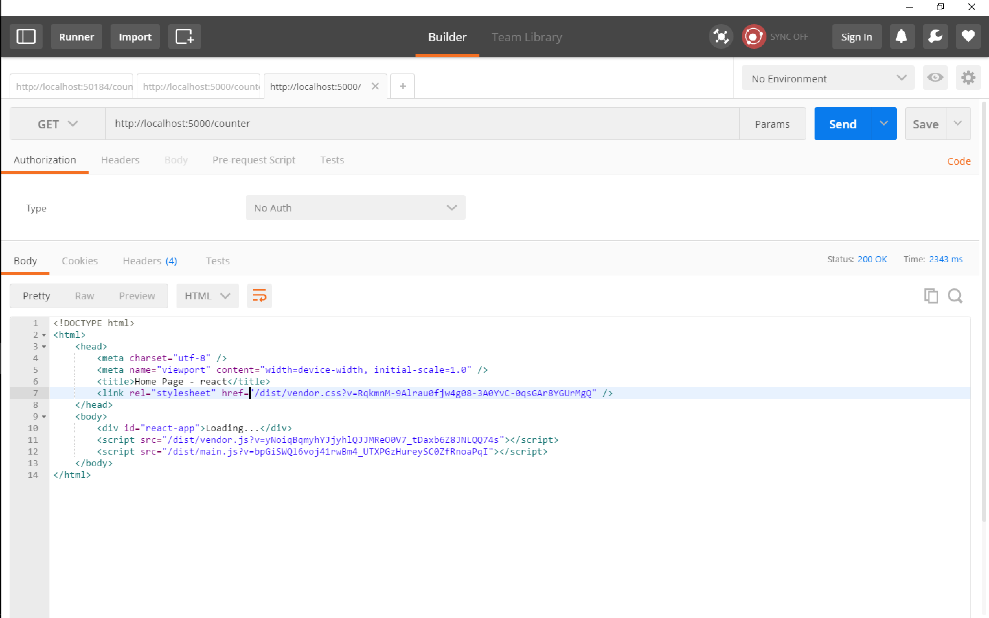
SPA iz perspektive klijenta

Slide 27
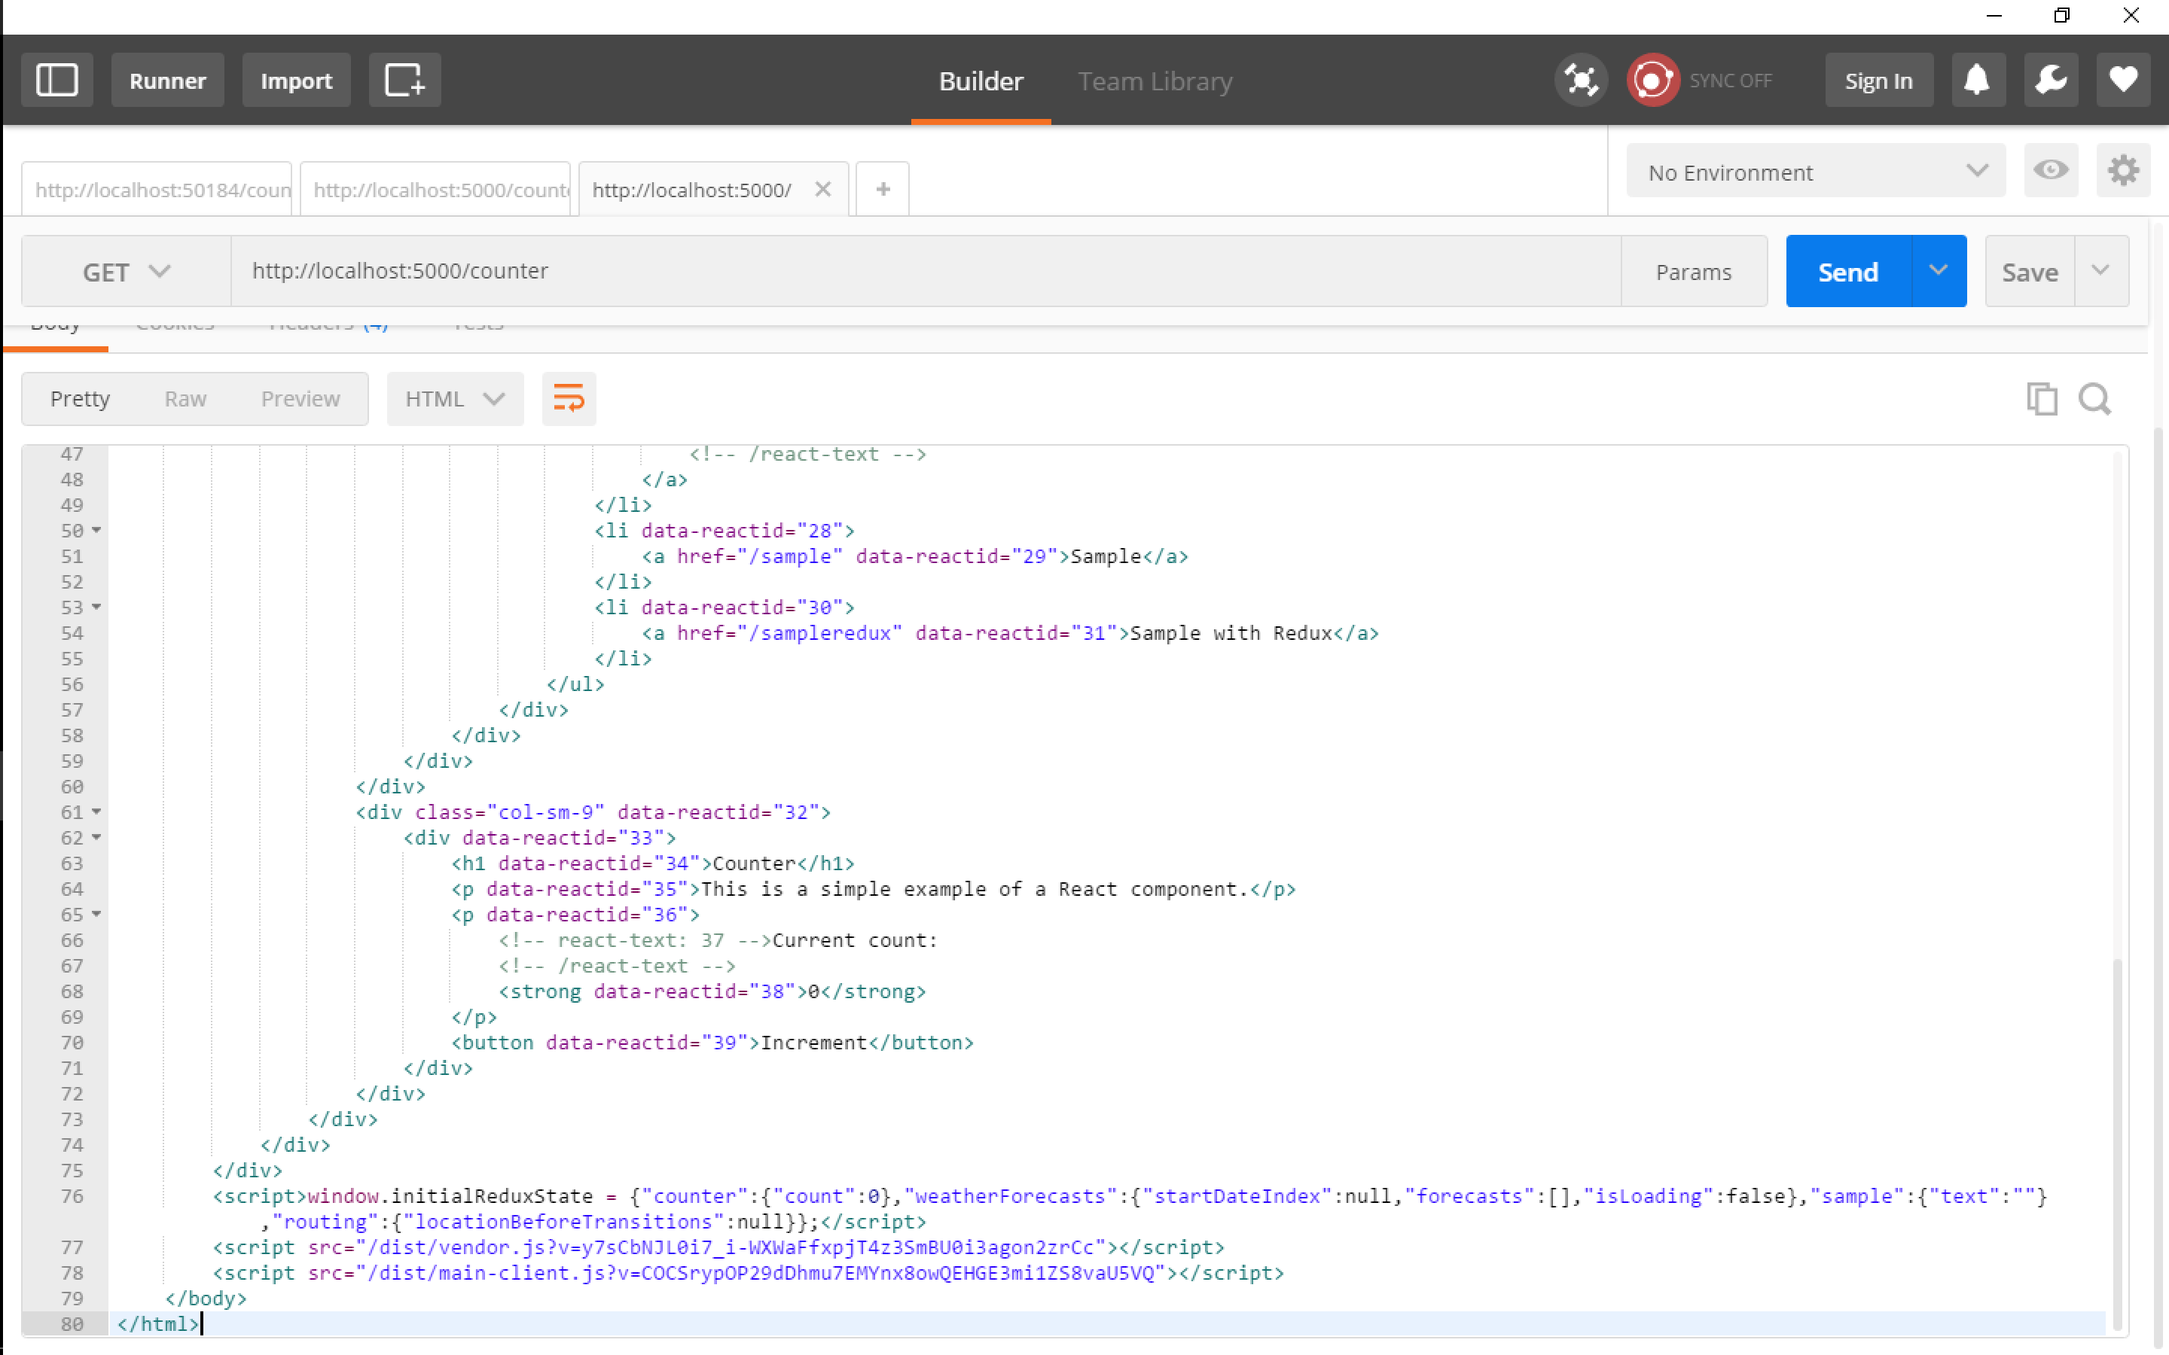
SPA & Server Side Prerendering

Slide 28
Redux
Complex state management

Slide 29
Zaključak
SPA framework olakšava izradu kompleksnih aplikacija
React je jedan SPA framework
Komponente su reusable

Slide 30
Hvala!
Toni Petrina
Massive Pixel d.o.o.
@to_pe
toni@massivepixel.co

